Slide 1

PA 881
International Cost Benefit Analysis

Slide 2
Introduction to PA 881
Today
- getting to know each other
- course details
Past projects

Slide 3
Introduction to PA 881 – instructor
Very very brief intro
Notes:
I usually talk about my research a bit but in the interest of time I will save that for later in the semster

Slide 4
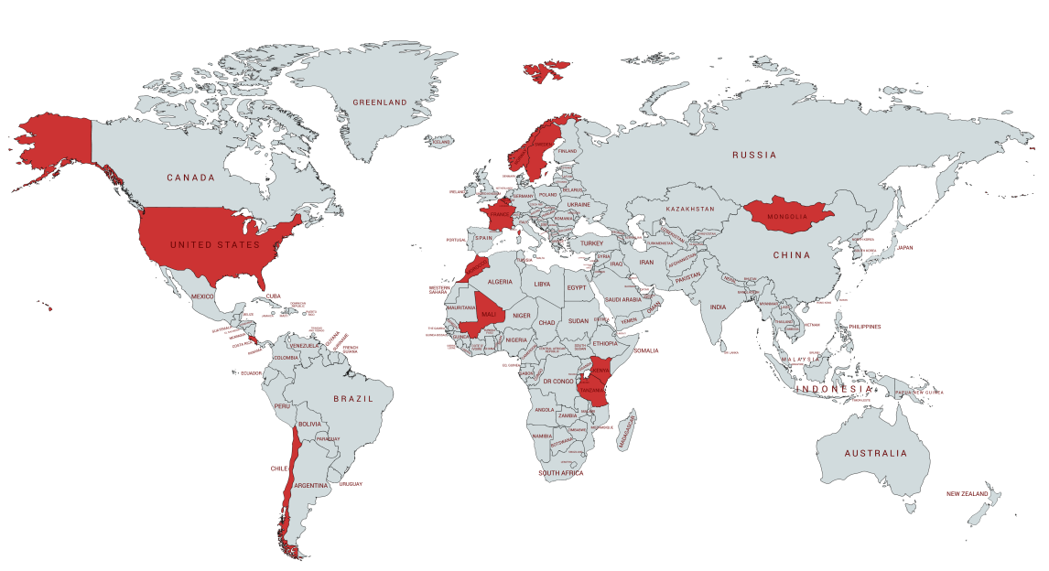


Slide 5



Slide 6
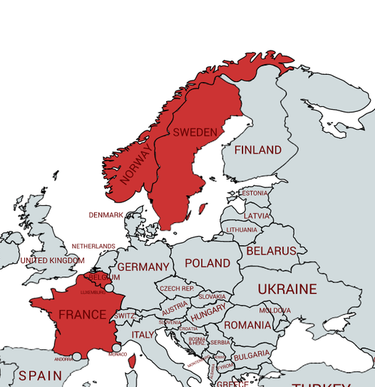

Slide 7
Introduction to PA 881 – students!
Name, preferred pronouns
Where are you from?
Country / regional interests?
What is one topic that you hope we will learn about this semester?
What talent do you have that you think nobody appreciates nearly as much as they should?

Slide 8
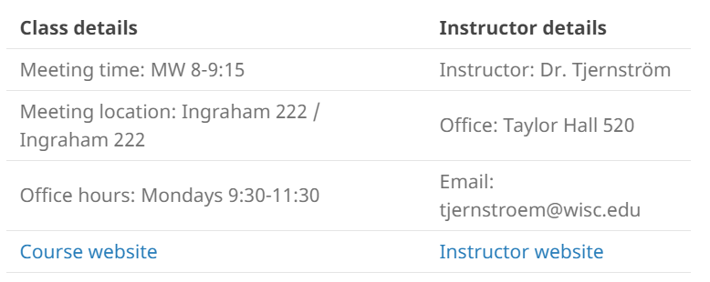
Introduction to PA 881 – course details
Notes:
UPDATE

Slide 9
Introduction to PA 881 – what’s CBA?
Should the Kenyan government the electricity network to reach millions of rural households?
Notes:
Let’s put on our policy-maker hats. What should we think about? Turn to the person next to you, introduce yourself, and chat for a few minutes about this question.
Cost?
…to government?
Phase 1: KShs.13.5 Billion to add connectivity to 1.5 million households ($130 million)
…to individuals?
…to society? (how is electricity generated?)
Benefits?
… how much do these households value it?
… what if we consider air quality impacts of cooking w/ cleaner fuels?

Slide 10
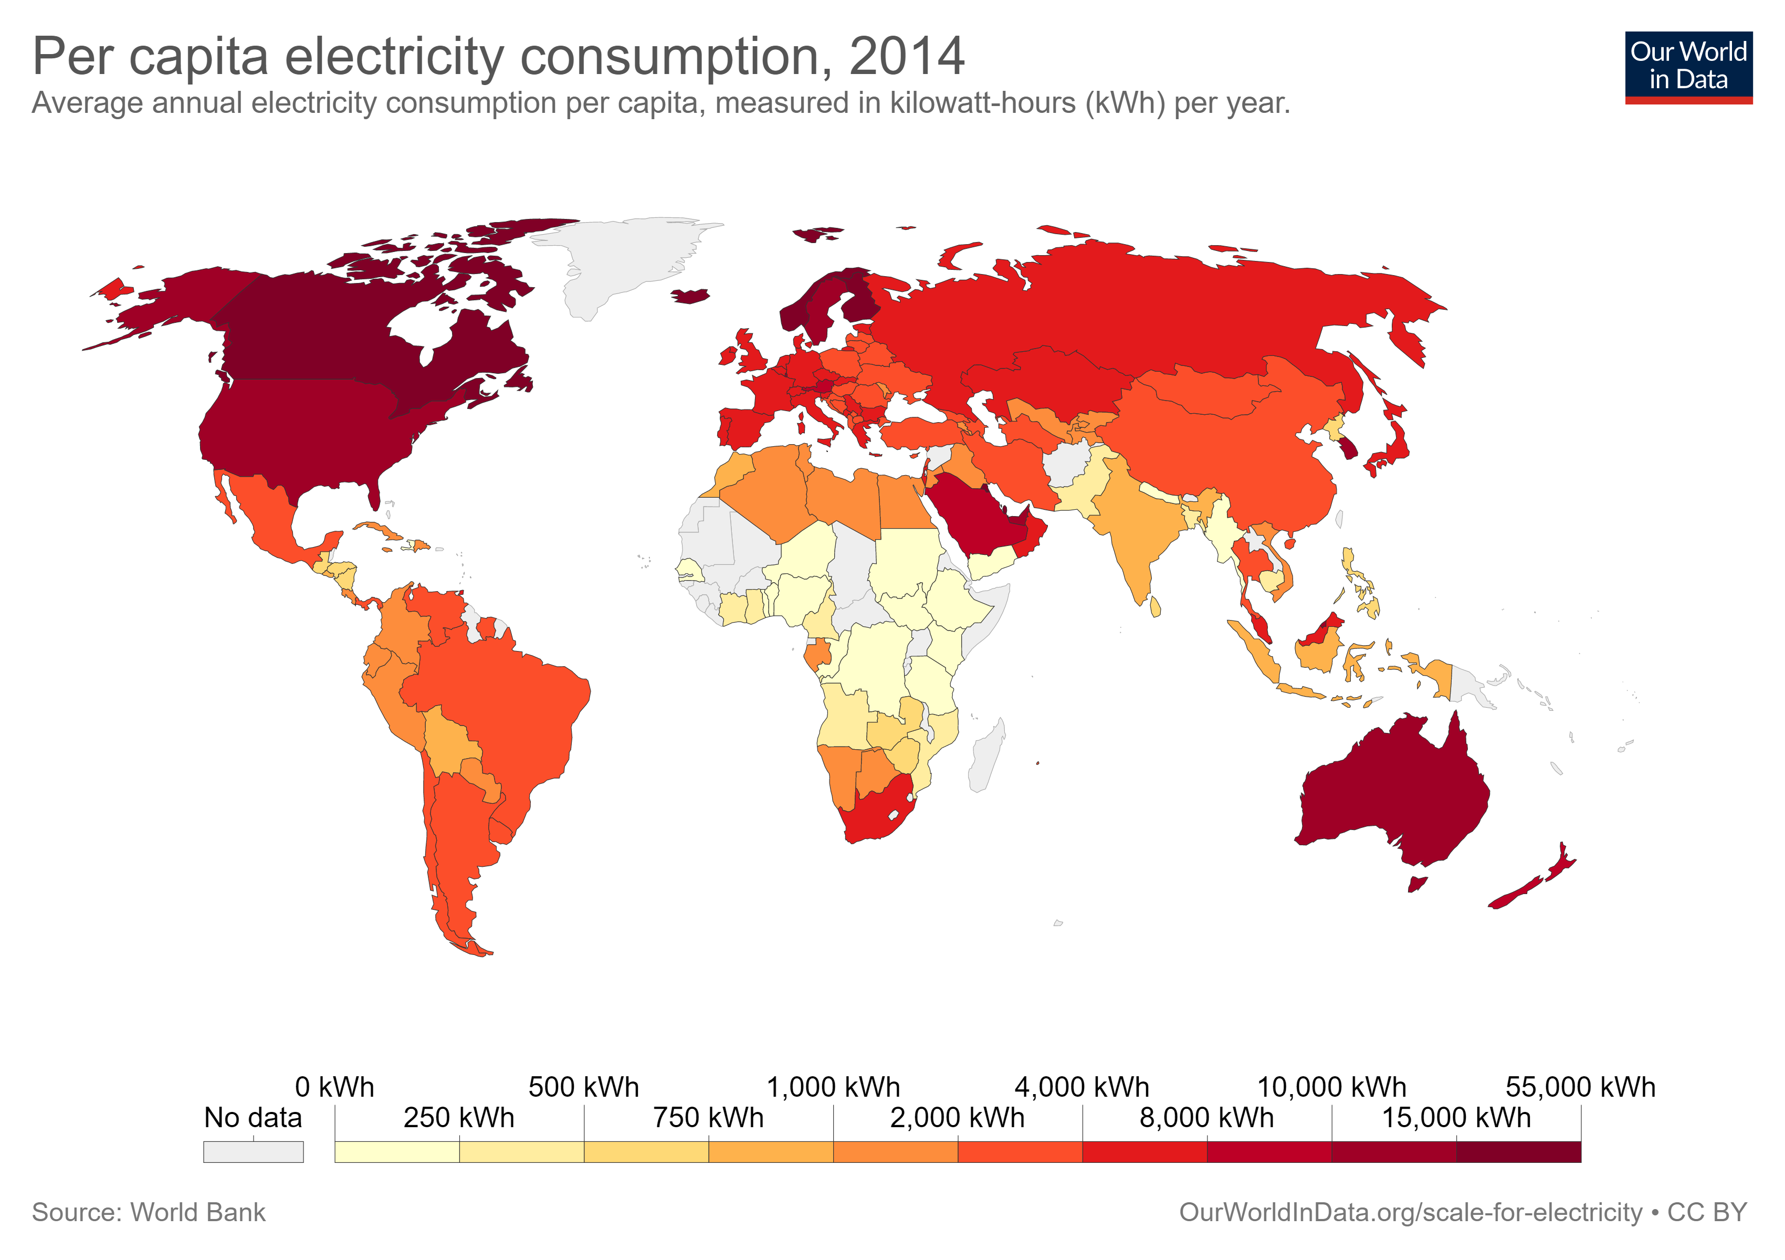

Slide 11
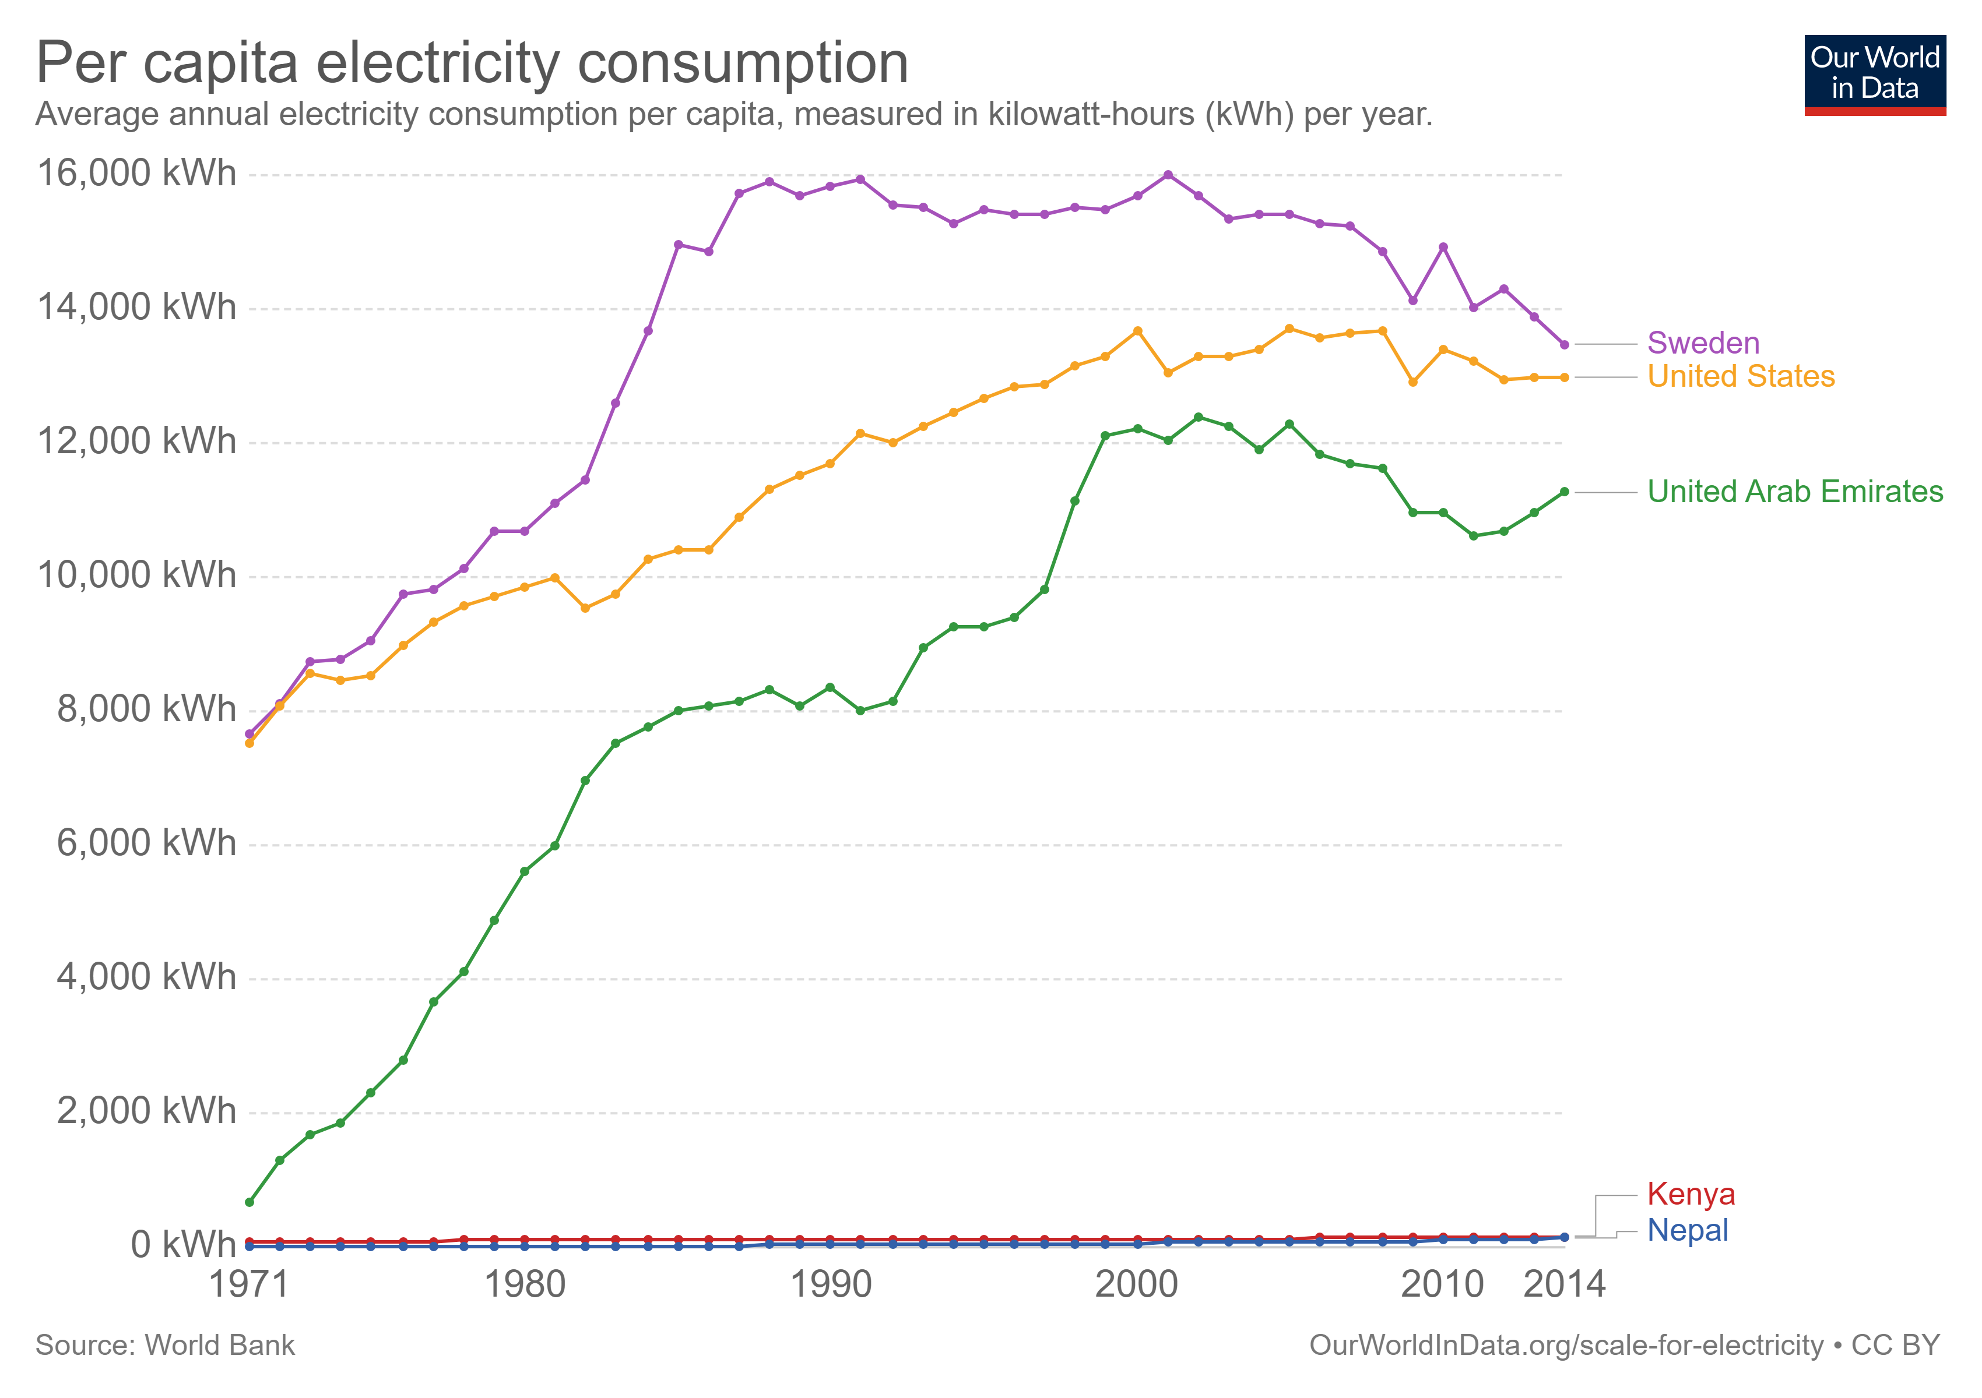

Slide 12
Introduction to PA 881 – what’s CBA?
Should the Kenyan government expand the electricity network to reach millions of rural households?
Notes:
Let’s put on our policy-maker hats. What should we think about?
Cost?
…to government?
Phase 1: KShs.13.5 Billion to add connectivity to 1.5 million households ($130 million)
…to individuals?
…to society? (how is electricity generated?)
Benefits?
… how much do these households value it?
… what if we consider air quality impacts of cooking w/ cleaner fuels?

Slide 13
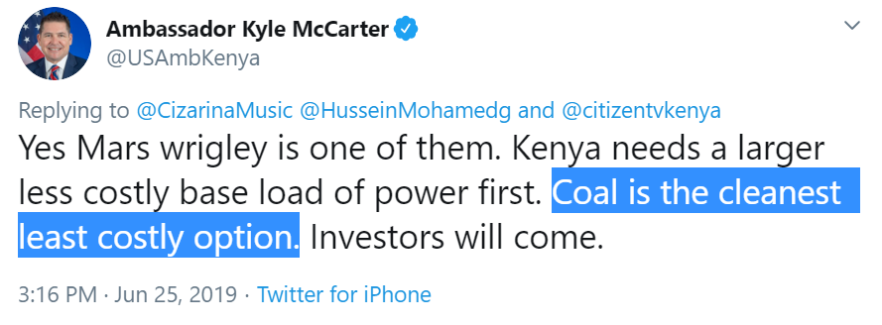
Introduction to PA 881 – what’s CBA?
Should the Kenyan government expand the electricity network to reach millions of rural households?
Notes:
Let’s put on our policy-maker hats. What should we think about?
Cost?
…to government?
Phase 1: KShs.13.5 Billion to add connectivity to 1.5 million households ($130 million)
…to individuals?
…to society? (how is electricity generated?)
Benefits?
… how much do these households value it?
… what if we consider air quality impacts of cooking w/ cleaner fuels?

Slide 14
Introduction to PA 881 – what’s CBA?
What about the Environmental Protection Agency (EPA)? Should they consider “co-benefits” when making decisions about environmental regulation?

Slide 15
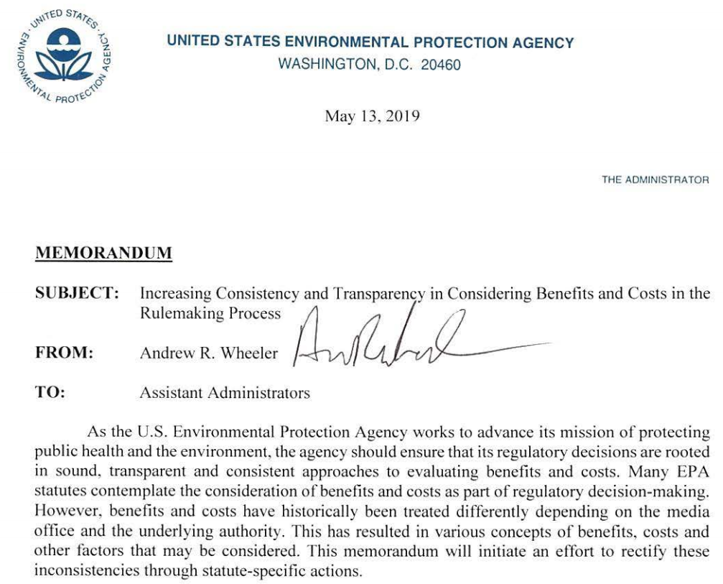
Introduction to PA 881 – what’s CBA?

Slide 16
Introduction to PA 881 – what’s CBA?
What about the EPA? Should they consider “co-benefits” when making decisions about environmental regulation?
…and what are co-benefits, anyway?
Co-benefits are the indirect benefits of a rule or agency action
Particularly relevant to the Clean Air Act's National Ambient Air Quality Standards (NAAQS)
Notes:
benefits from enacting a rule outside of the specifically designed to create

Slide 17
Introduction to PA 881 – what’s CBA?
What about the EPA? Should they consider “co-benefits” when making decisions about environmental regulation?
…and what are co-benefits, anyway?
Good CBA counts everything on both sides of the ledger
We want to weigh the social costs and the social benefits, i.e. maximize the net benefits of activities / regulations / policies on society
Notes:
If a regulation will lead to reductions in particulate matter in the air, reducing asthma & heart attacks? That counts!

Slide 18
Introduction to PA 881 – objectives
At the end of the semester you will
…have an informed opinion on these topics!
…grasp the main tools and concepts of CBA
…be able to diagnose if a policy-question is well-suited for a CBA
…be able to make and justify modeling assumptions in your analysis
…be aware of elements that may compromise the validity of an CBA
…effectively communicate the results of a CBA to relevant parties

Slide 19
Introduction to PA 881 – reqs & grades
Assessment
Class participation (10%)
Stata exercise (10%)
Midterm (30%)
Peer feedback (10%)
CBA project (40%)

Slide 20
Introduction to PA 881 – reqs & grades
All course materials & submissions due electronically (PDF) on Canvas
Please name files according to this convention:
- Assignment_FirstName_LastName (for individual work)
- Assignment_ProjectName (for group projects)

Slide 21
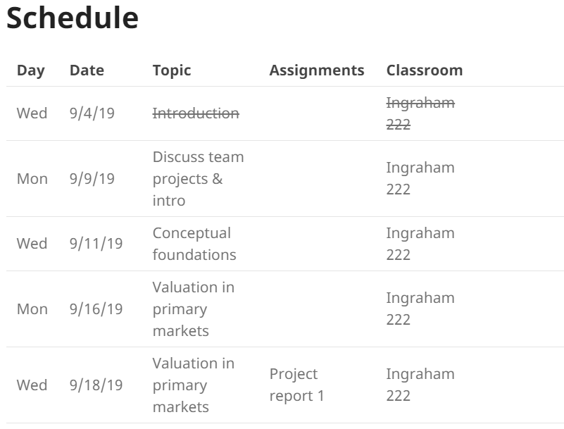
Introduction to PA 881 – schedule
Schedule
Detailed schedule
Notes:
Note that because theory is the same, the beginning of the semester will be joint with Weimer’s section

Slide 22
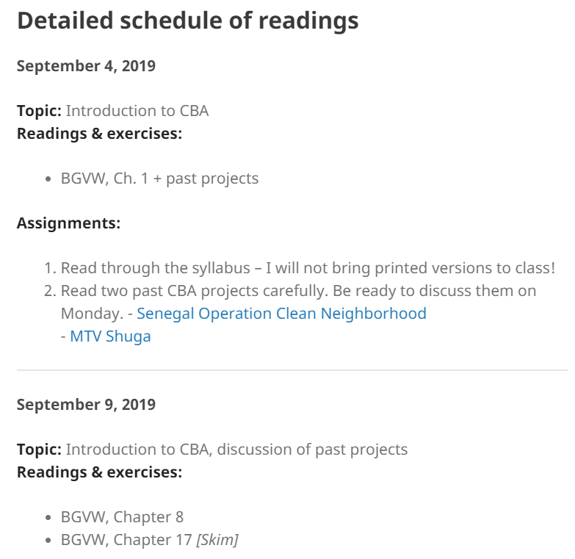
Introduction to PA 881 – schedule
Schedule
Detailed schedule

Slide 23
Introduction to PA 881 – readings
Required book
Anthony E. Boardman, David H. Greenberg, Aidan R. Vining, and David L. Weimer, Cost- Benefit Analysis: Concepts and Practice, 5th ed. [BGVW]
Other materials on the course website (and occasionally on Canvas)
Notes:
Rules

Slide 24
Introduction to PA 881 – overview
Questions so far?

Slide 25
Introduction to PA 881 – values
 |  | BEST class ever | WORST class ever
What the … did
students
instructor
Notes:
Diversity – to me the main thing we can do in class is to create a welcoming learning environment
Use these to agree on how we want to manage our shared learning environment
3 knocks for off-topic
Rule of 3

Slide 26
Introduction to PA 881 – values
Diversity & inclusion
Academic integrity
Religious observances
missing class? let me know in the first 2 weeks of class
Electronics
Notes:
Diversity – to me the main thing we can do in class is to create a welcoming learning environment
If a religious observance will require that you miss class time, please notify me within the first two weeks of class of the specific days or dates on which you request relief.

Slide 27

Source: https://www.brookings.edu/research/for-better-learning-in-college-lectures-lay-down-the-laptop-and-pick-up-a-pen/
Notes:
Randomly assigned to note take on laptop or by hand.
Randomization ensures that on average the students using electronics in a study are comparable to those who aren’t. Those who took notes on laptops understood the material worse.
Students using a laptop also distract their colleagues.
Real-world: United States Military Academy (USMA): electronics, no electronics, tablets flat on table (same teacher teaches several sections)

Slide 28
Introduction to PA 881 – values
Diversity & inclusion
Academic integrity
Religious observances
missing class? let me know in the first 2 weeks of class
Electronics
evidence shows personal tech lead to poor learning
+ negative externalities for other students’ ability to learn
Notes:
Ask me for needed accommodations
Have mentioned this to Prof Weimer – he feels less strongly about it and is leaning more towards a soft ban; if problematic let’s discuss

Slide 29
Introduction to PA 881 – overview
Questions?

Slide 30
Past projects
In small groups, discuss the questions that you came up with regarding the two projects
MTV Shuga
Senegal operation clean neighborhood

Slide 31
Past projects
What policy or program did the team assess?
What are the major categories of costs and benefits?
What were the estimated net benefits?
What did you find the most interesting about each CBA?
What strikes you as the weakest aspect of each CBA?
Across projects, what similarities do the projects share in terms of format?

Slide 32
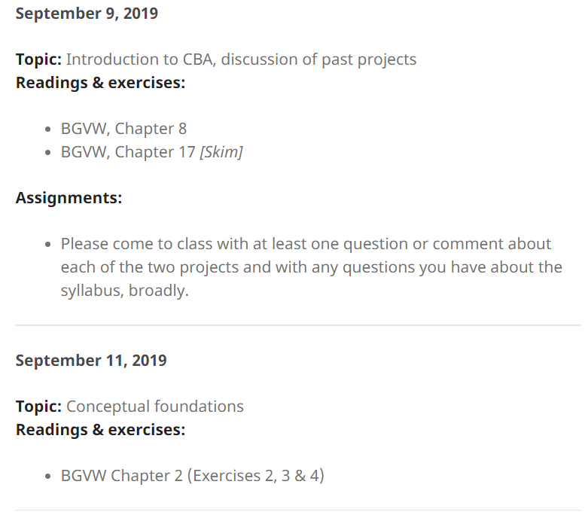
For next class

Slide 33
New resource on Google Scholar & data
Getting started with teams & Google resources (also linked from Schedule page)

Slide 34
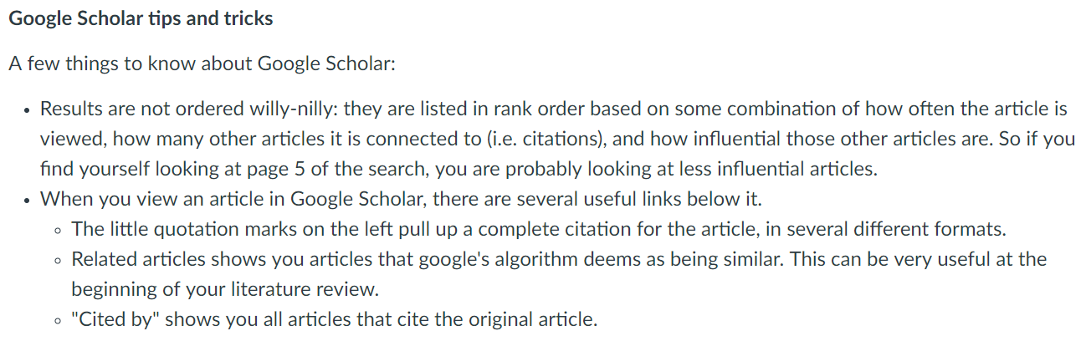
New resource on Google Scholar & data

Slide 35
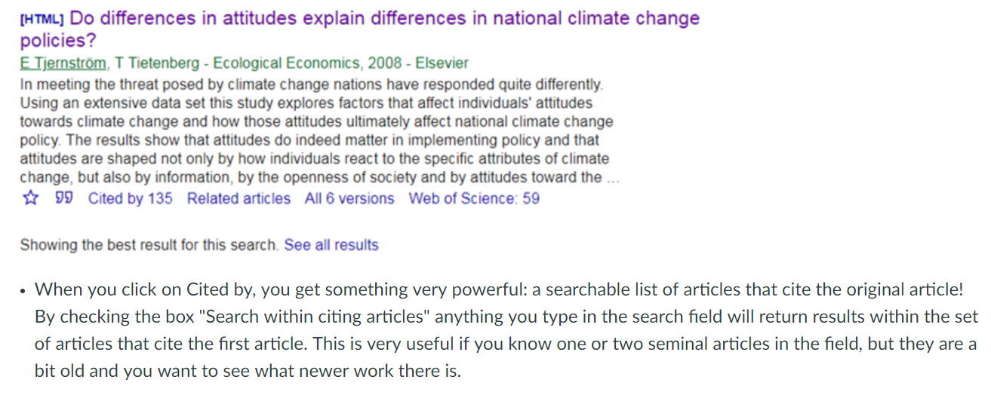
New resource on Google Scholar & data

Slide 36
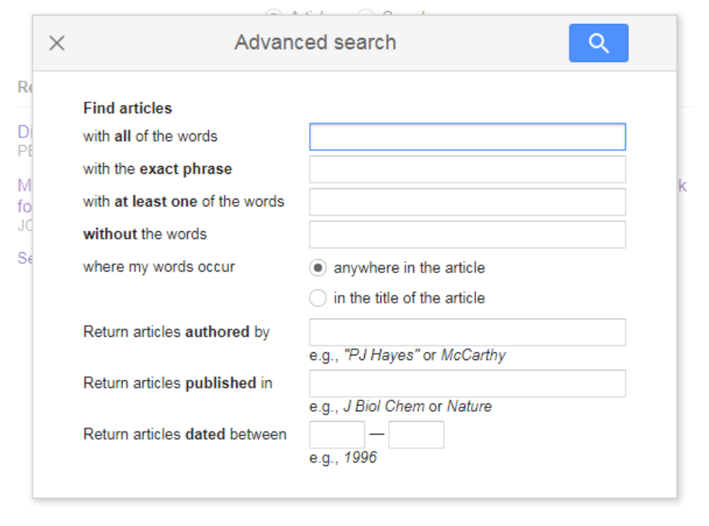
New resource on Google Scholar & data

Slide 37
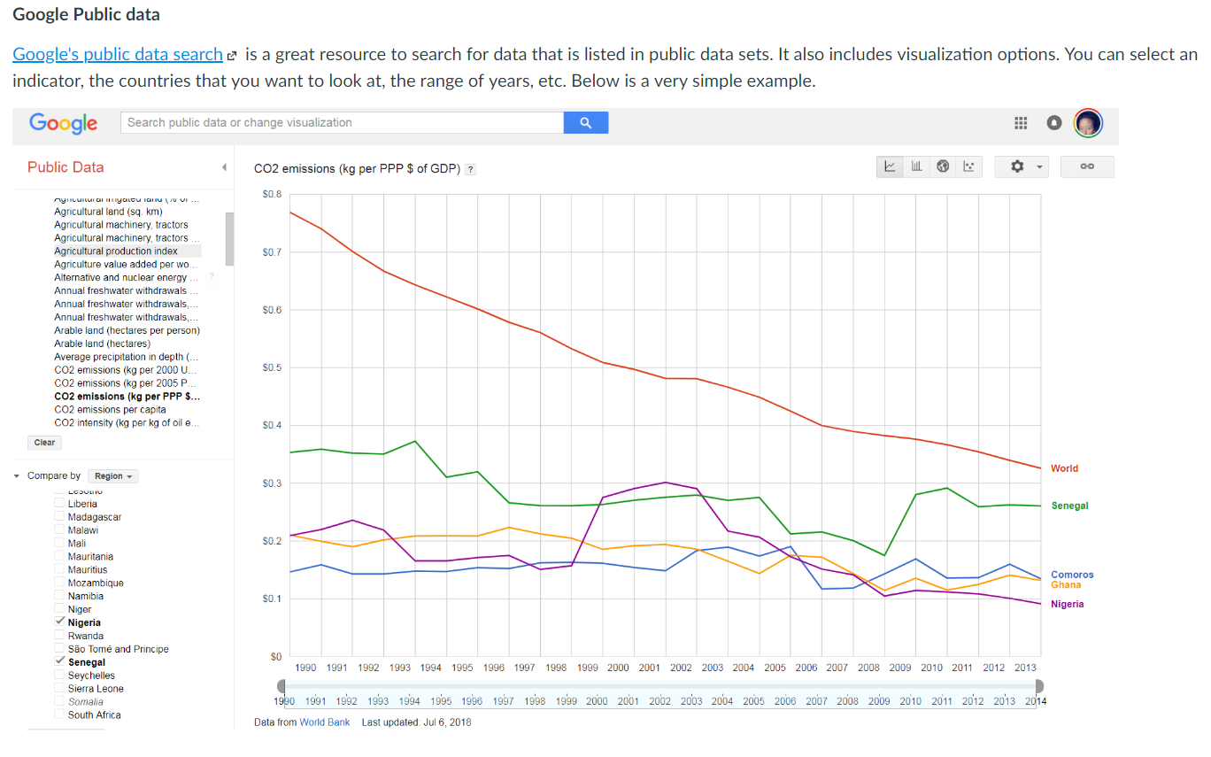
New resource on Google Scholar & data

Slide 38
Questions?

